Slide 1
STEP 2 – KNOW YOUR USER
Our apps sit rep…

Slide 2
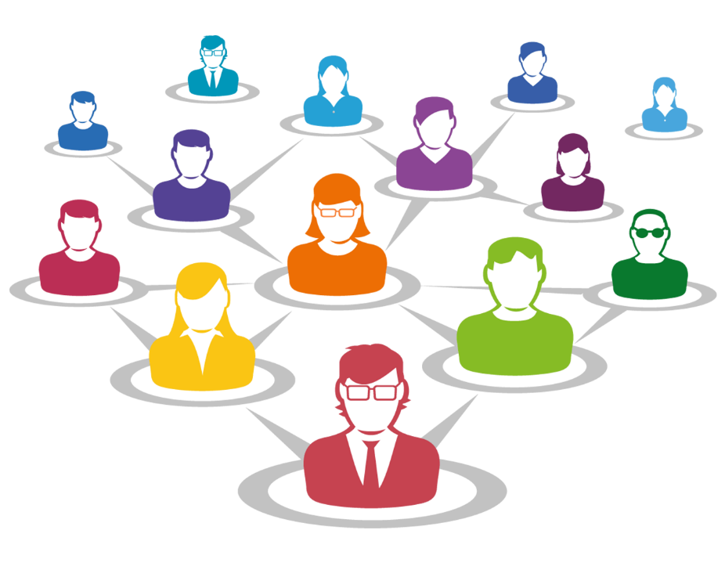
Step 2 Know Your User
The more you know about your user, the more you know about your app
Users can usually be broken down into groups of reasons to use the app for example for Facebook:
Keep in touch with friends & family
Build an online photo album
Promote my business
Send viral messages to large groups of people
All of these people will use Facebook differently

Slide 3
Step 2 Know Your User
The users for our tracking app fall into two groups:
Drivers, the ones who update the app with correct delivery times and status
Customers, the ones who track where goods are and when they will arrive
There are also some things both groups might want such as:
An easy-to-use design
A secure login
To be accessible
All these combined give us the app’s requirements

